Slide 1
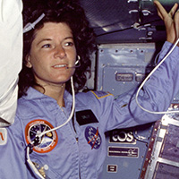
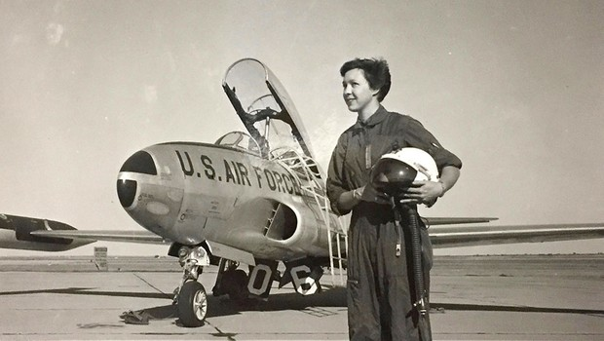
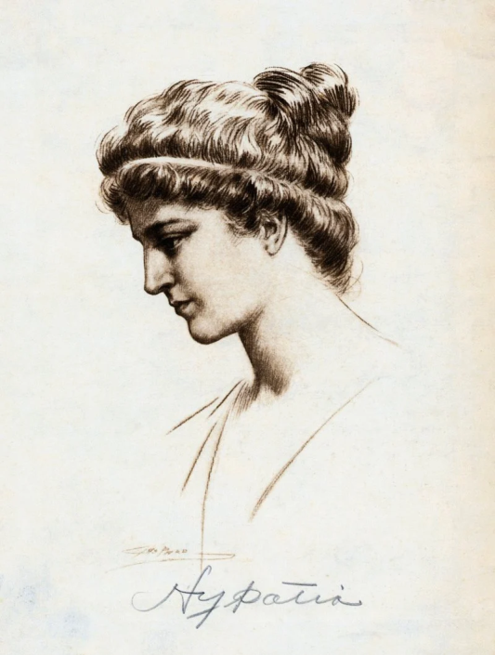
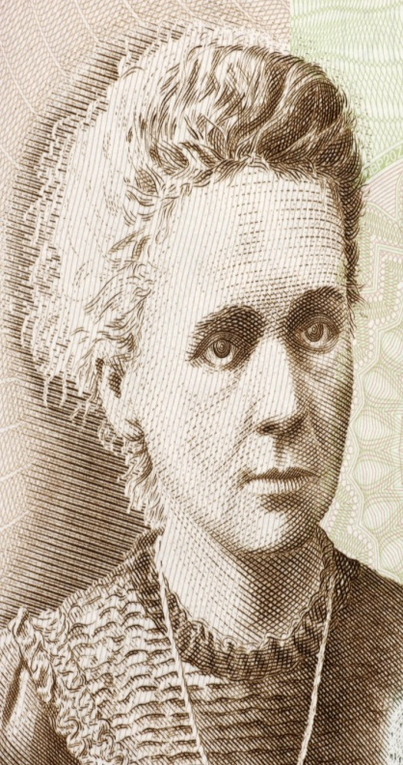
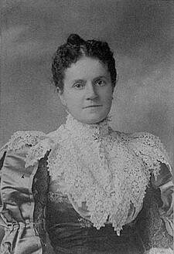
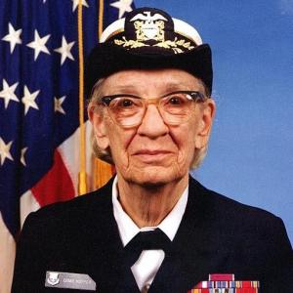
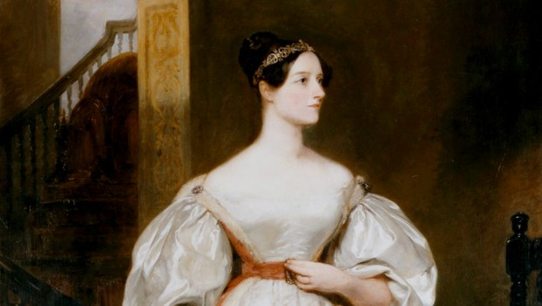
WOMEN OF STEM

Slide 2
WHAT IS STEM?
SCIENCE
TECHNOLOGY
ENGINEERING
MATHEMATICS

Slide 3
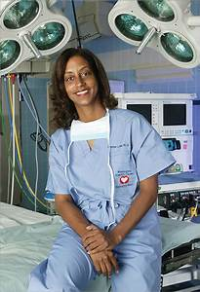
WHY IS STEM IMPORTANT FOR WOMEN?
Counteract stereotypes and biases
Represent the female perspective
Diversity makes better science
More female role models leads to more females attracted to STEM fields

Slide 4
STEM PIONEERS PAVED THE WAY
QUALITIES OF STEM PIONEERS
LET’S LOOK AT SOME OF THE PIONEERS AND THOSE CARRYING ON THE LEGACY
Brave; courageous; fearless
Bold
Risk takers
Visionary
Able to think outside the box
Creative
Able to handle criticism
Wouldn’t take “no” or “girls don’t do that” for an answer

Slide 5
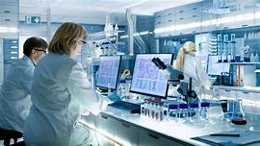
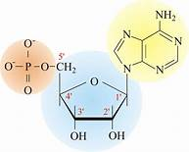
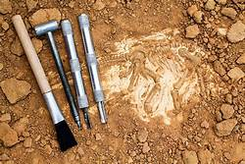
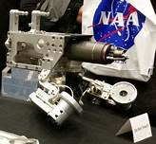
SCIENCE PIONEER

Slide 6
CAROLINE HERSCHEL 1750-1848
German Astronomer
First woman to receive a salary as a scientist
Between 1786 – 1797 discovered eight comets
Led the way for other women to follow in natural science-related fields…

Slide 7
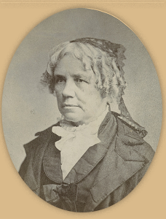
NATURAL SCIENCE FIELDS: PHYSICS (physicists, astronomers, astrophysicists)
MARIA MITCHELL
1818-1889
1st female astronomer in the USA
1st American scientist to discover a comet
ANNIE JUMP CANNON
1863-1941
Astronomer
1st women to receive a doctorate in astronomy
“Census taker of the sky”
Developed Harvard Spectral System (way stars are classified)

Slide 8
NATURAL SCIENCE FIELDS: PHYSICS (physicists, astronomers, astrophysicists)
LISE MEITNER
1878-1968
Physicist
Doctorate in Physics
“Mother of Nuclear Fission”
Has an element named after her: meitnerium

Slide 9
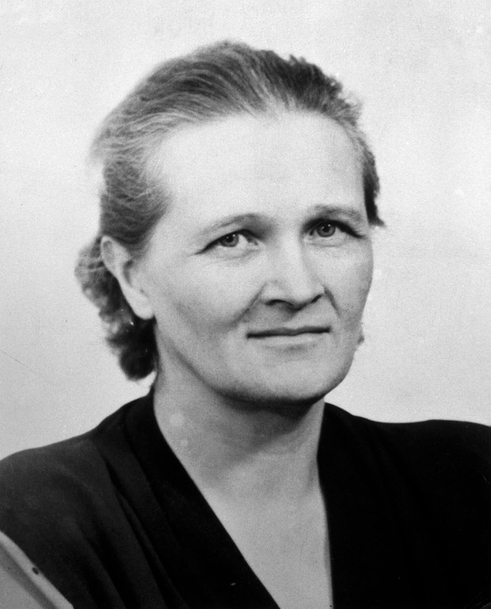
NATURAL SCIENCE FIELDS: PHYSICS (physicists, astronomers, astrophysicists)
CECILIA PAYNE-GAPOSCHKIN
1900-1979
Astrophysicist
Discovered the composition of stars (hydrogen & helium)
NANCY GRACE ROMAN
1925-2018
Astronomer
“Mother of the Hubble Telescope”
Nasa’s first chief astronomer

Slide 10
NATURAL SCIENCE FIELDS: CHEMISTRY (chemists)
MARIE CURIE
1867-1934
Chemist and physicist
1st woman to win a Nobel Prize (Physics) for work on the theory of radioactivity (1903)
Won the 1911 Nobel Prize in Chemistry for discovering the elements polonium and radium
Only person to win a Nobel Prize in two scientific fields

Slide 11
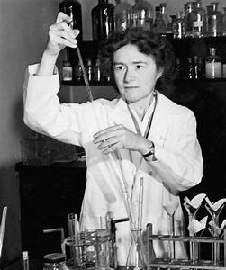
NATURAL SCIENCE FIELDS: CHEMISTRY (chemists)
GERTY THERESA CORI
1896-1956
Biochemist with a doctorate
1st USA women to win a Nobel Prize in science (1947)
Researched how glucose is metabolized, providing key insight into the treatment of diabetes
MARY ENGLE PENNINGTON
1872-1952
Bacteriological chemist with a
doctorate in chemistry
Worked at the U.S. Department of Agriculture
Researched sanitary methods for food safety

Slide 12
NATURAL SCIENCE FIELDS: CHEMISTRY (chemists)
ROSALIND FRANKLIN
1921-1958
PhD Chemist
Contributed to discovering the structure of DNA
DOROTHY HODGKIN
1910-1994
PhD Chemist
Discovered structure of insulin
Won a Nobel Prize for chemistry (1964) for her work with biochemical substances

Slide 13
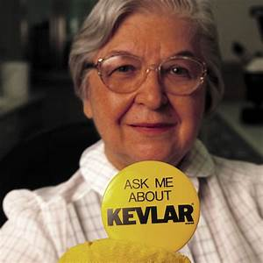
NATURAL SCIENCE FIELDS: CHEMISTRY (chemists)
STEPHANIE KWOLEK
1923-2014
Chemist
1st female research chemist
Discovered Kevlar
From Pittsburgh, PA

Slide 14
NATURAL SCIENCE FIELDS: BIOLOGY (biologists, ecologists, conservationists)
RACHEL CARSON
1907-1964
Marine biologist and conservationist
“Mother of Modern Environmentalism”
Helped ban dangerous chemical pesticides
(like DDT)
Her environmental movement led to the creation of the Environmental Protection Agency (EPA)
From Pennsylvania (just NE of Pittsburgh)
JANE GOODALL
1934-
Primatologist
Her observations of chimpanzees redefined our understanding of the relationship between humans and other animals

Slide 15
NATURAL SCIENCE FIELDS: EARTH SCIENCE (geologists, meteorologists, paleontologists)
MARY ANNING
1799-1847
Paleontologist
Discovered first complete fossil of a dinosaur
ReBecca Hunt-Foster
1979 -
Paleontologist
Works with dinosaur remains from the Late Jurassic to Late Cretaceous Periods

Slide 16
NATURAL SCIENCE FIELDS: ASTRONAUTS (usually have specialized in one of sciences or in engineering)
WALLY FUNK
1939-
Pilot/flight instructor
One of the “Mercury 13” who trained as an astronaut in 1960-61
SALLY RIDE
1951-2012
Physicist and astronaut
1st American woman in space (1983)

Slide 17
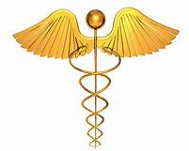
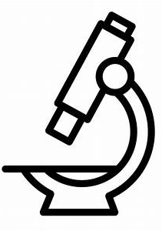
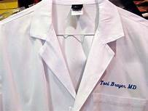
MEDICAL HEALTH SCIENCES PIONEER

Slide 18
ELIZABETH BLACKWELL 1821-1910
First woman to receive a medical degree in the USA (1849)
Led the way for other women to follow in the medical health sciences

Slide 19
MEDICAL HEALTH SCIENCES (medicine, nutrition, genetics, immunology, virology…)
JUNE ALMEIDA
1930-2007
Virologist
Perfected immune electron microscopy
Identified first human coronavirus
FLORENCE NIGHTINGALE
1820-1910
Nurse
Patient care advocate
Made hospitals cleaner and safer

Slide 20
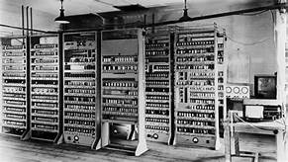
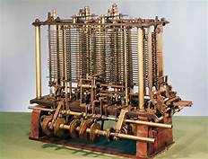
TECHNOLOGY PIONEER

Slide 21
ADA LOVELACE 1815-1852
English Mathematician
Computer Scientist
Developed an algorithm for the ‘Analytical Engine’ (mechanical general-purpose computer)
First computer programmer
Second Tuesday in October is known as Ada Lovelace Day to celebrate the achievements of women in STEM careers
Led the way for other women to follow in technology-related fields

Slide 22
TECHNOLOGY GRACE HOPPER 1906-1992
Computer Scientist
Mathematician
1st woman to achieve a PhD in math
Pioneer computer programmer
Wrote computer language in English rather than math notation
Developed COBOL
US Navy Rear Admiral

Slide 23
TECHNOLOGY
MARY KELLER
1913-1985
1st female PhD in computer science
Co-developed BASIC computer language (1958)
HEDY LAMARR
1914-2000
Invented a remote-controlled communication system for the US Military
That system serves as the basis for today’s communication technology (including WIFI)

Slide 24
TECHNOLOGY
ELIZABETH FEINLER
1931-
American Information Scientist
Director of the network information systems center at the Stanford research institute
Introduced domain name protocol
(.com, .net, .gov)
MARY WILKES
1937-
Computer programmer
Helped develop the first personal computer
1st person to have a PC in her home

Slide 25
TECHNOLOGY
ADELE GOLDBERG
1945-
Built programming language for Graphical User Interface (GUI)
(Allows windows to overlap display screens)
RADIA PERLMAN
1951-
PhD in computer science
Software designer
Network Engineer
“Mother of the Internet” (created STP which is a fundamental operation for network bridges)

Slide 26
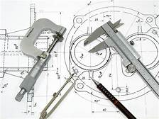
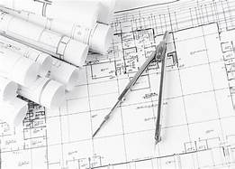
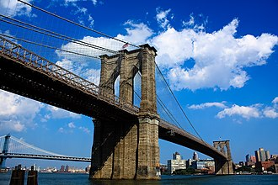
ENGINEERING PIONEER

Slide 27
EMILY ROEBLING 1843-1903
Civil Engineer
1st female field engineer
Oversaw completion of the Brooklyn Bridge (1883)
Led the way for other women to follow in engineering fields…

Slide 28
ENGINEERING
LILLIAN GILBRETH
1878-1972
Industrial engineer
1ST female member of the American Society of Mechanical Engineers
Worked with GE to improve design of kitchen and household appliances
EDITH CLARK
1883-1959
Electrical engineer
1st professionally employed female engineer in the USA (1922)
1st female Professor of
Electrical Engineering in the USA

Slide 29
ENGINEERING
MARTHA COSTON
1826-1904
Created signaling flare system (Coston Flares)
Still used by the US Navy today!
MARY ANDERSON
1866-1953
Invented the windshield wiper (1903)

Slide 30
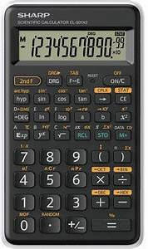
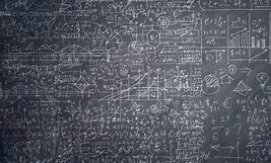
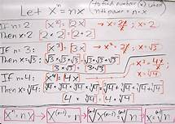
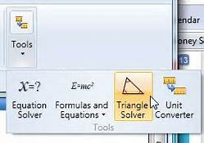
MATHEMATICS PIONEER

Slide 31
HYPATIA 370-415
Egyptian Mathematician
1st female math teacher
Also taught astronomy
Led the way for other women to follow in mathematical fields…

Slide 32
MATHEMATICS
KATHERINE JOHNSON
1918-2020
Mathematician
NASA “human computer” (did equations by hand)
Did trajectory analysis, launch windows, and emergency back up return paths for the space program
Featured in movie “Hidden Figures”
ADA LOVELACE
1815-1852
English Mathematician
Developed an algorithm for the ‘Analytical Engine’ (mechanical general-purpose computer)
Human calculating machine

Slide 33
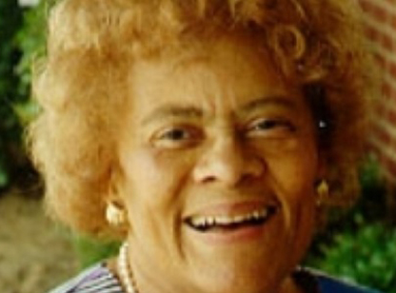
MATHEMATICS
Marjorie Lee Browne
1914-1979
Mathematician
1st African-American women to earn a PhD in mathematics
Known for her contributions to the world of numbers and equations
Encouraged and promoted math education for minorities and women

Slide 34
STEM AND YOU
If interested in pursuing a STEM field:
Take 4 years of math
Take as much lab science as possible
Participate in STEM-related extra-curricular activities (math club, science fairs, Science Olympiad, robotics)
Talk to those involved in STEM fields

Slide 35
STEM AND YOU
PICTURE YOURSELF…
Digital imaging specialist (video games, entertainment industry, medical devices)
Computer scientist, programmer, designer
Engineer
Scientific researcher
Medical doctor
Mathematician
Forensic scientist
Your dream STEM-field job…

