Slide 1
HyperDuino and Turing Tumble, Say What? Say STEM!
Marcie Erickson
marciaerickson22@gmail.com
Beta Epsilon
Hilton Scranton & Conference Center
Room: Casey B
Saturday, June 12, 2021
10:30 A.M.-11:30 A.M.

Slide 2
Workshop Purpose:
To share two STEM activities procured through grants in order to provide support to classroom teachers who are interested in partnering with the library and integrating STEM activities into their classrooms or content areas.

Slide 3
Today’s Activities:
Introduction: Brown Bag Activities 1 & 2
HyperDuino Introduction, Demonstration, and Hands-On Exploration
Turing Tumble Introduction, Demonstration, and Hands-On Exploration
Wrap-up: Brown Bag Activity 3

Slide 4
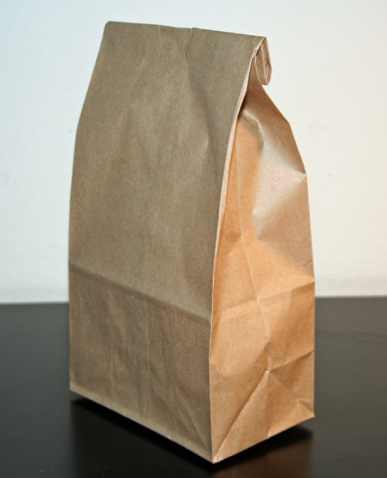
Brown Bag Activity 1
With a partner, open a brown bag and divide the parts into a HyperDuino pile and a Turing Tumble pile.

Slide 5
Brown Bag Activity 2
When a part’s name is called out, partners take turns holding up what is thought to be the correct item.

Slide 6
HyperDuino

Slide 7
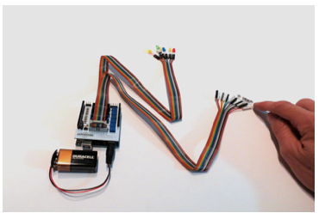
HyperDuino
HyperDuino integrates STEM into any classroom or content area.
It uses a “Low Walls/High Ceiling” philosophy.
It provides students an opportunity to tinker, invent, and code by designing an interactive maker project that blends physical media such as bifolds/trifolds, dioramas, or models with digital media and coding in context.

Slide 8
HyperDuino
Why use HyperDuino?
Easily adapts to existing projects
Aligns with the strategic and extended thinking on Webb’s Depth of Knowledge framework
Allows for coding in context
Integrates STEM in a natural, not forced, manner
What do I need to get started?
Physical project materials and related tools
HyperDuino kit
HyperDuino Media Linker app
Chromebook
What are some useful resources?
www.hyperduino.com
@hyperduino
@rogerwagner
www.auntgoodiebags.com/
@AuntGoodiebags

Slide 9
HyperDuino Demonstration

Slide 10
Turing Tumble

Slide 11
Turing Tumble
Turing Tumble can integrate STEM into classrooms, maker spaces, or enrichment activities.
Using Turing Tumble, students build mechanical computers powered by marbles to solve logic puzzles.
It provides students an opportunity to learn key computer science concepts and build skills essential to coding.

Slide 12
TuringTumble
Why use Turing Tumble?
Can be used as a stand alone, a precursor, or as a supplement or enrichment activity
Lessons address math, computer science, coding, and engineering concepts and principles
Aligns with the strategic and extended thinking on Webb’s Depth of Knowledge framework
Easy to implement -requires no batteries or apps to use
What do I need to get started?
Turing Tumble Kit
Turing Tumble Educator Guide
Turing Tumble Practice Guide
What are some useful resources?
www.turingtumble.com/
www.facebook.com/TuringTumble
@TuringTumble
www.youtube.com/channel/UCXn_01FyDa4gP48Yrvx4LuA/featured

Slide 13
Turing Tumble Demonstration

Slide 14
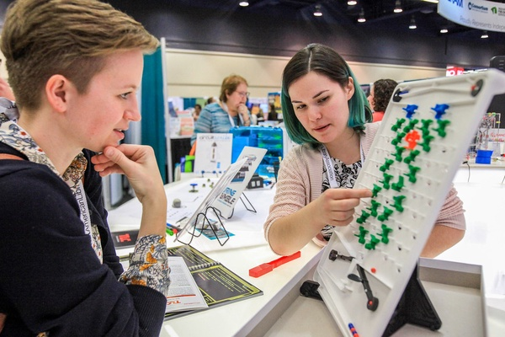
Explore: HD & TT
Try out and explore the HyperDuino and Turing Tumble kits until 11:25 A.M.

Slide 15
Brown Bag Activity 3
Open your “goodie” brown bag and pull out the index card and pen. Write down your most important workshop take-away on the index card, place it in the basket, and enjoy the goodies!

Slide 16
Thank you!

Slide 17
Credits:
Presentation Template: SlidesMania
Images:
Unsplash
"Brown Bag (without staple)" by Jeffrey Beall is licensed under CC BY-SA 2.0
"2019 alamidwinter" by ALA - The American Library Association is licensed under CC BY-NC-SA 2.0

