Slide 1
Online Game Development
A Scratch Workshop
Kaylyn Gibilterra

Slide 2
Installation
To download an app (so that you don’t need an internet connection) https://scratch.mit.edu/download
This allows you to download the app onto your computer - mac or windows or chrome OS
Can also be on Android - wouldn’t be ideal for this workshop
To get started immediately: https://scratch.mit.edu/projects/editor/

Slide 3
What does it mean to teach STEM topics?
It has [shockingly] little to do with learning specific technologies
Everything to do with breaking down ambiguous problems

Slide 4
Distributed Systems: What we wish existed
Website
Mobile
Customer Servicing Agents
Database

Slide 5
Distributed Systems: What we have
Unknown count
Website
Mobile
Customer Servicing Agents
324 of these
Database (for bank 1)
Database (for bank 2)
Database (for bank 3)
Database (for bank 4)

Slide 6
Distributed Systems: How Senior Engineers Try to Solve It
Website
Mobile
Customer Servicing Agents
The Better Database
Database (for bank 1)
Database (for bank 2)
Database (for bank 3)
Database (for bank 4)

Slide 7
Distributed Systems: How Senior Engineers Try to Solve It
Website
Mobile
Customer Servicing Agents
The Better Database
Oh oops - no this database will be better...
Database (for bank 1)
Database (for bank 2)
Database (for bank 3)
Database (for bank 4)

Slide 8
Distributed Systems: How Senior Engineers Try to Solve It
Website
Mobile
Customer Servicing Agents
Database Routing
Database (for bank 1)
Database (for bank 2)
Database (for bank 3)
Database (for bank 4)

Slide 9
Distributed Systems: How Senior Engineers Try to Solve It
Website
Mobile
Customer Servicing Agents
Database Routing
Database (for bank 1)
Database (for bank 2)
Database (for bank 3)
Database (for bank 4)
A Better Database

Slide 10
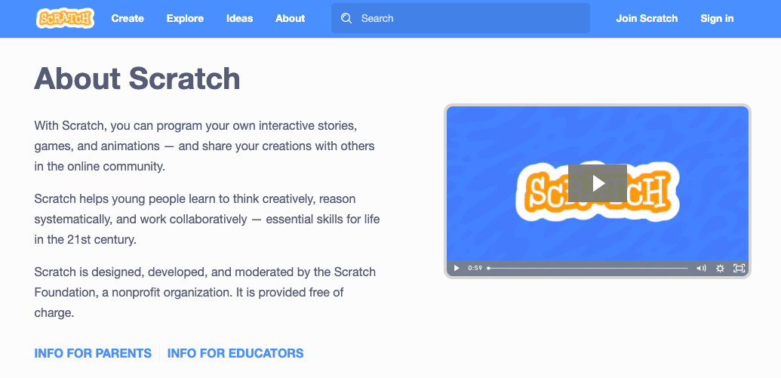
What is Scratch?

Slide 11
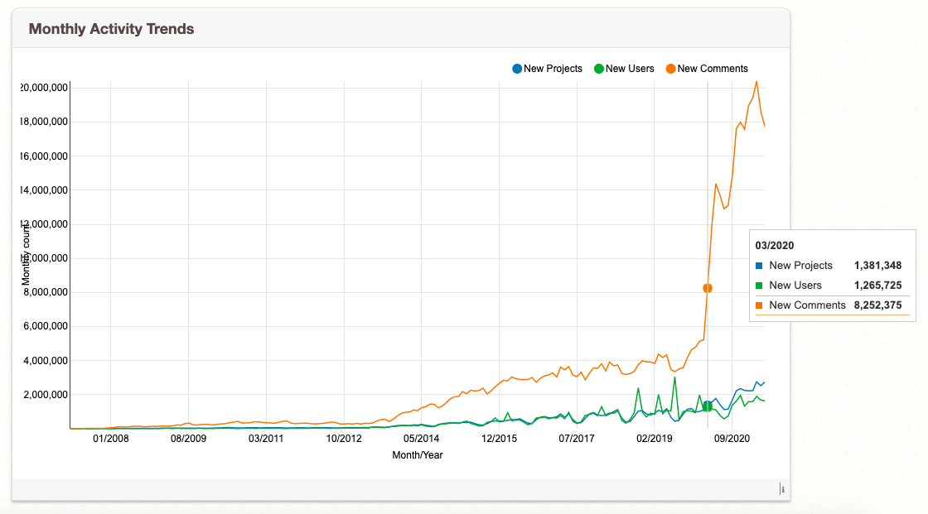
Scratch Statistics

Slide 12
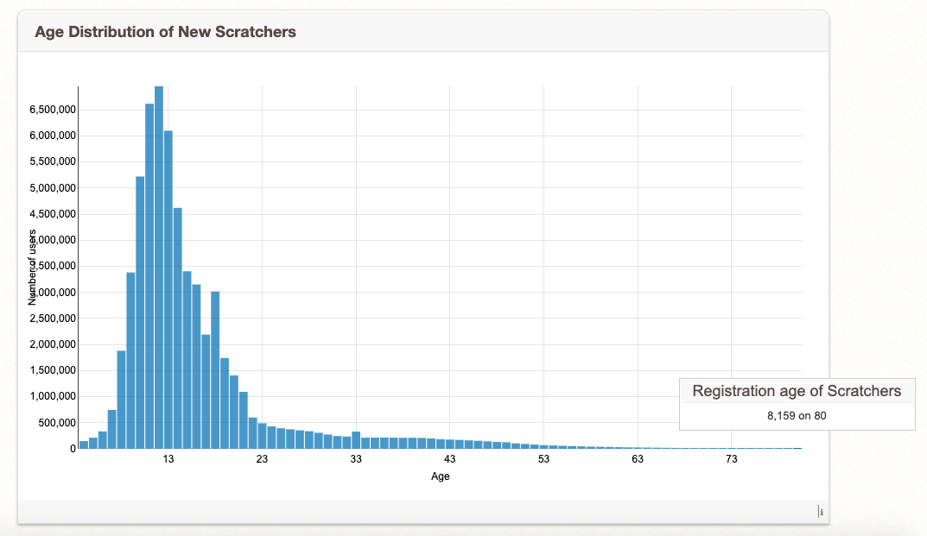
Scratch Statistics

Slide 13
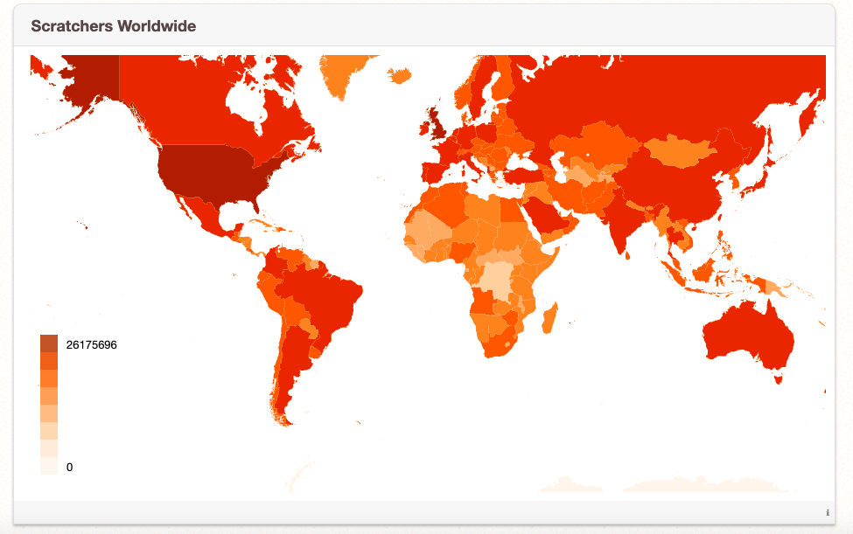
Scratch Statistics

Slide 14
Scratch Project
Tutorial: https://scratch.mit.edu/projects/editor/?tutorial=home
Start with an existing idea: https://scratch.mit.edu/ideas
Start from scratch: https://scratch.mit.edu/projects/editor/

Slide 15
Resources
Educator Guides: https://resources.scratch.mit.edu/www/guides/en/EducatorGuidesAll.pdf
CS First Program: https://csfirst.withgoogle.com/s/en/home
Research behind Scratch: https://cacm.acm.org/magazines/2020/11/248219-coding-at-a-crossroads/fulltext
Statistics about Scratch: https://scratch.mit.edu/statistics/

